Slide 1
AIG Plan 2019-2022
Heather Boston, Aig coordinator

Slide 2
Article 9B: Academically or intellectually gifted students
§ 115C-150.7. Local plans. (a) Each local board of education shall develop a local plan designed to identify and establish a procedure for providing appropriate educational services to each academically or intellectually gifted student. (d) A plan shall remain in effect for no more than three years; however, the local board may amend the plan as often as it considers necessary or appropriate.

Slide 3
Carteret County Schools strives to create a learning environment in which gifted student's are provided a rigorous, engaging curriculum that addresses the unique strengths, talents and abilities of our learners. Our school system will recognize, cultivate, and value gifted students' unique needs from entrance into school through graduation. We will work to engage and educate ALL stakeholders on the learning needs of our gifted students in order to ensure they reach their full potential.

Slide 4
Increased local PD, resources and support for classroom teachers of gifted students
Portfolio process for identification
AIG Steering Committee
Utilization of MTSS as part of screening, referral, identification, and services
Additional pathways for communication between families of gifted students and the AIG Department
Expanded talent development program
This Photo by Unknown Author is licensed under CC BY-SA-NC

Slide 5
Standard 1: Student Identification
Screening-Universal Screening data, Cognitive Abilities Test, EOG/EOC
Referral-Anyone can refer
Identification-Academically and Intellectually Gifted, Intellectually Gifted, Highly Gifted, Academically Gifted Reading, Academically Gifted Math, Academically Gifted (reading and math)
Intellectual: 95th percentile/artifact
Academic: 95th percentile 2 of 3 years, or 95th percentile on individually administered, nationally normed assessment, or Portfolio
Under-represented-Universal Screening, Portfolio, Communication, PD, Nurturing
AIG Steering Committee and coordinator will monitor data to ensure consistent implementation of screening, referral and identification procedures; procedures communicated via coordinator and specialists
Identification documented consistently across the county with paperwork

Slide 6
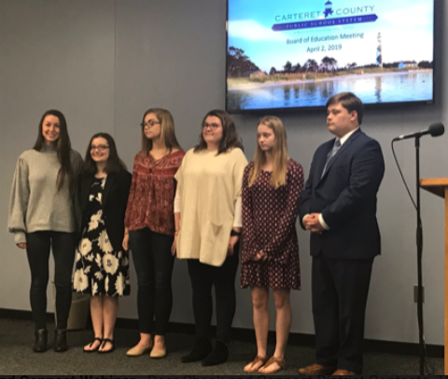
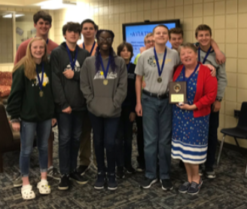
Standard 2:Comprehensive programming within a total school community
Pull-out, clustering, push-in, consultations, acceleration, social emotional learning
Not all services are provided by AIG specialist, most are provided within the classroom by teacher therefore collaboration is necessary
Intentional grouping through MTSS I and E blocks, course choice at HS, cluster grouping based on area of eligibility
Increased communication through: Newsletters, DEP, PowerPoint of key points of plan, digital resource database, Professional Development, articulation meetings, GIT
SEL-training utilizing Neihart (2015), time with like peers
Acceleration opportunities and procedures that are clear including CDM, content, grade

Slide 7
Standard 2 extracurricular
Elementary
Math Fair
Art Club
STEM Club
Battle of the Books
Stock Market Game
Book Club
Underwater ROV
Plays/Musicals
Math Club
Chess Club
Cooking Club
Music Club
Young Authors Competition
Middle School
Art Club
Geography Bee
Scripps National Spelling Bee
Quiz Bowl
Battle of the Books
Robotics
Guitar Club
Envirothon
Drama Club
Mate ROV
TSA
Project Lead the Way
Young Authors Competition
National Junior Honor Society or BETA Club
High School
Governor's School
Honors Courses
Math Competition
College Courses
North Carolina School of Science and Math IVC Courses
Youth and Government Club
Skills USA Competitions
Future Business Leaders of America
National Honor Society or Beta Club
History Day Competition
Young Authors Competition

Slide 8
Standard 3: Differentiated Curriculum and instruction
Differentiation occurs through content, process, or product.
Content – Change pace, depth and or complexity of the material. Teachers may teach different or more difficult material. They may go deeper into the subject matter or cover the content in greater complexity.
Process - Teacher may present material at a faster pace, use higher levels of thinking or use different teaching strategies. The purpose is to provide strategies that challenge high-end students and stretch their thinking at a more advanced level.
Product – Teachers provide options for students to demonstrate mastery of the core curriculum content.
Instructional Practices: Compacting, Critical Thinking Strategies, Flexible Grouping, Tiered Assignments, Extension Menus, Learning Contracts, Interest Centers, Independent Study, Grade Acceleration, Socratic Seminars, Problem Based Learning
Resources: Beast Academy, Zaccaro Math, AIG Instructional Resources Project, Jacob’s Ladder, William and Mary Curriculum, Duke Tip Teacher Workshop, PBL Project, Project M2, U-STARS, NCSSM Resources, Junior Great Books, Lego Robotics, Bloxels
Utilize data to determine student need, on-going data collection throughout the year
Talent Development Program-Grades K-3, data driven, supported through MTSS
DEP’s and Newsletters

Slide 9
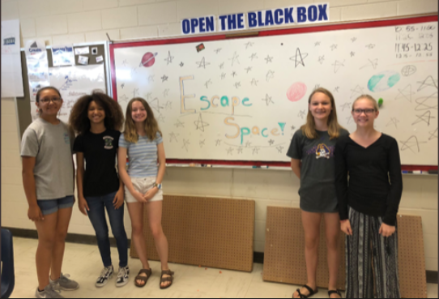
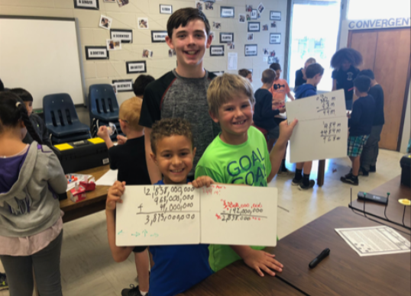
Standard 4: Personnel and Professional Development
Gifted specialists oversee the implementation of this plan in the building, support teachers in implementing the plan
Everyone that works with children needs to be knowledgeable of plan and it’s components
Teachers need more support to work with AIG students in the classroom
Year-long, comprehensive, local AIG professional development-cohort based
Due to limited specialists, we must work as a team to create resources and provide for the students

Slide 10
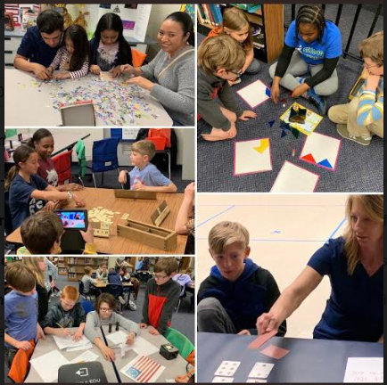
Standard 5: Partnerships
AIG Parent Advisory, cross county events
AIG plan on website, pamphlet for parents, PD, annual presentation to the Board of Education
AIG Steering Committee to monitor implementation
Partnerships include STEAMEast, Duke TIP, NCSSM, CMAST, Duke Marine Lab, CTE

Slide 11
Standard 6: Program accountability
Plan requires local board approval, submitted to NCDPI for review and comment
Utilize feedback to determine professional development and coaching needs
Coordinator monitors the budget of approximately $440,000 from state funds, updates budget through finance prior to purchase approval
98% of budget is allocated to AIG Specialists and costs associated with positions
Ensure AIG student data and needs are visible and communicated consistently
Coordinator and specialists will monitor training, student growth data, eligibly and demographics, instruction provided in the classrooms, survey data, student to teacher ratios, drop-out data, student enrollments, and acceleration opportunities provided.

